Slide 1
INTRODUCTION
ShopNest is the leading department store in e-commerce in Portugal. It connects businesses from various regions in Portugal to channels. The overall detailed analysis of the company yearly has been created and compared below.

Slide 2
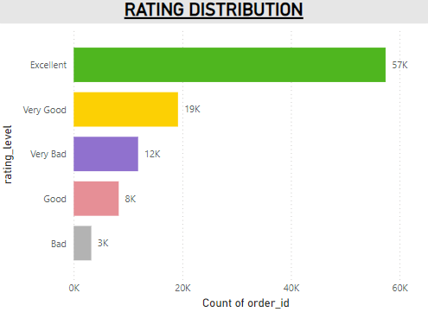
Q1) Identify the rating distribution in the Shop_Nest dataset, showcasing ratings categorized as Excellent, Very Good, Good, Bad and Very Bad along with corresponding orders.
Products which are rated Excellent are ordered the most. It is obvious that the customers would prefer quality of the products over anything. Hence, Excellent rating orders are highest followed by Very Good.

Slide 3
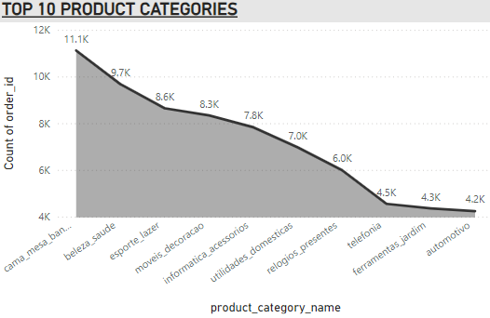
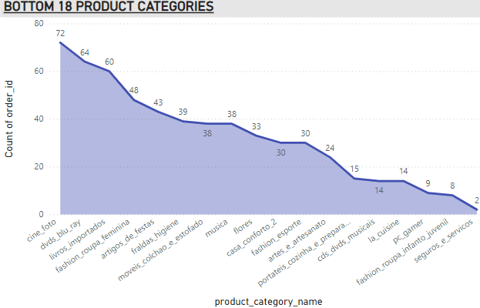
Q2) What are the Top 10 and Bottom 18 most popular categories in the ShopNest dataset? Please list them based on the number of orders.
Cama_mesa_banho product has the highest number of orders with 11115 orders. The automotivo product category is at the 10th place with 4235 orders.
Seguros_e_servicos is the least ordered product category with 2 orders.

Slide 4
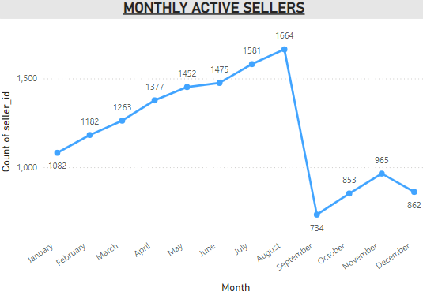
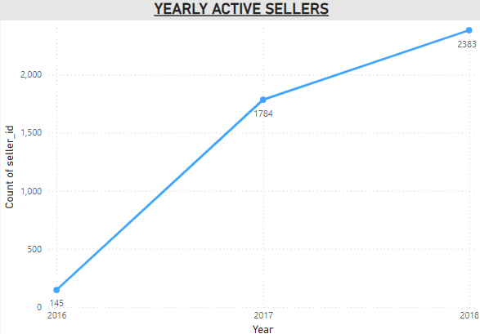
Q3) List total number of active sellers yearly and monthly.
Maximum number of sellers are available in the month of August with 1664 sellers, registering it the peak season time.
The active sellers have been increasing yearly as the reach and demand for the product kept increasing every year.

Slide 5
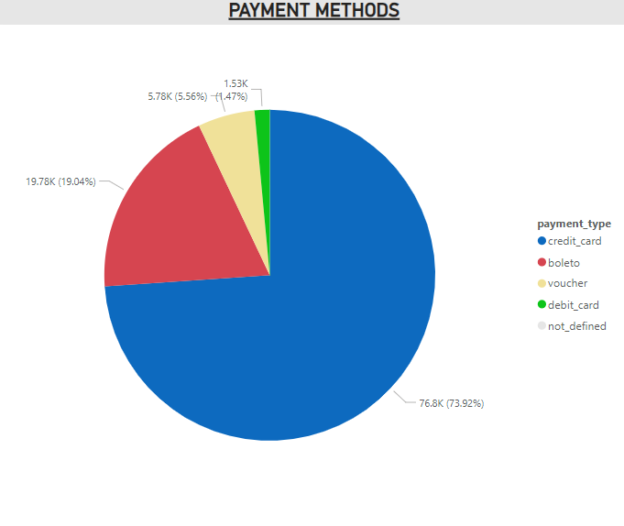
Q4) Which Payment methods are most commonly used?
As we see here, the most commonly used payment methods are via Credit Card Payments. Followed by Boleto and Voucher. As expected there will be a lot of offers for customers while using credit card. So they opt for Credit Card payments.

Slide 6
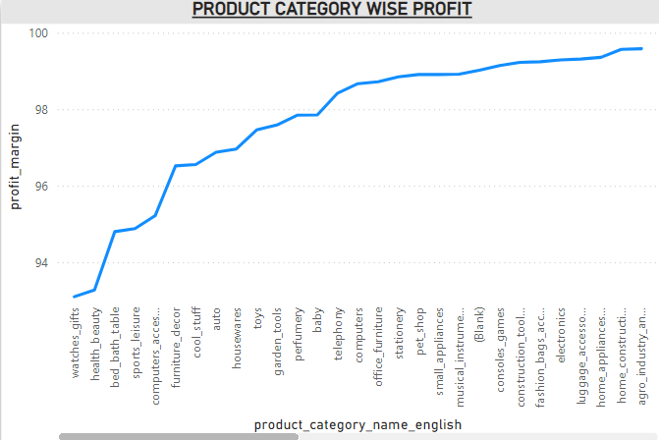
Q5) Identify the product category wise profit margin using formula.
The highest profit margin was for flowers, cds_dvds_musicals, fashion_children_clothes, home_comfort_2, security_and_services which was 100% and the product which generated the least profit was watches_gifts with 93.10% The total profit generated was 0.03K

Slide 7
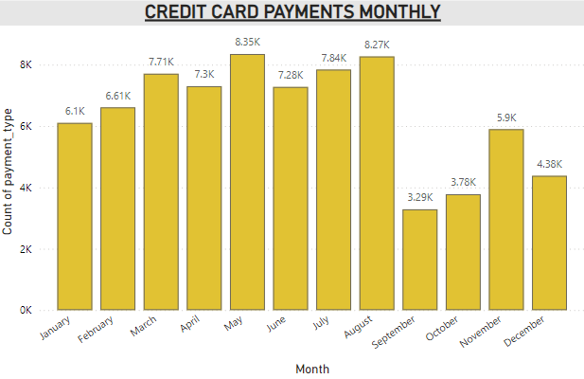
Q6) Determine monthly payments made by customers using credit cards.
Most of the credit card payments were made in the months of May and August. As we have seen earlier August is the peak season time.

Slide 8
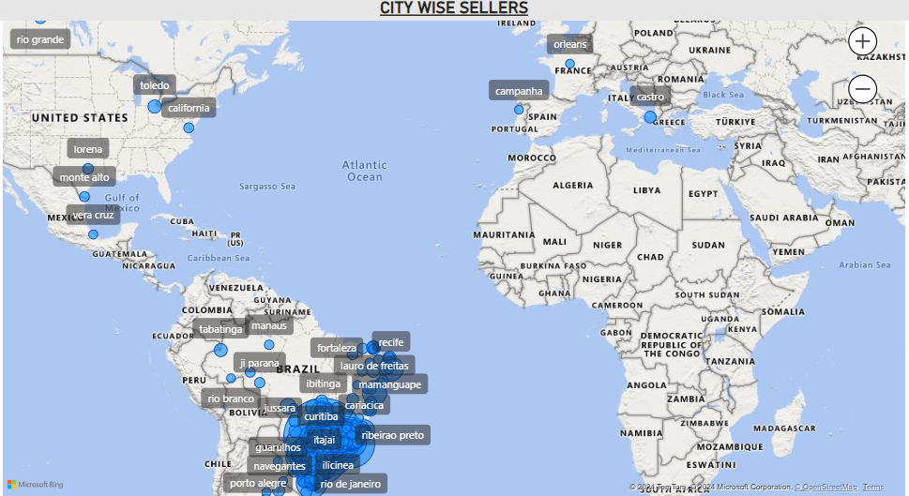
Q7) Identify sellers categorized by city, excluding cities starting with letters S and B.
The maximum number of sellers are present in ibitinga as it is the most populous city of Brazil with 7750 total sellers.

Slide 9
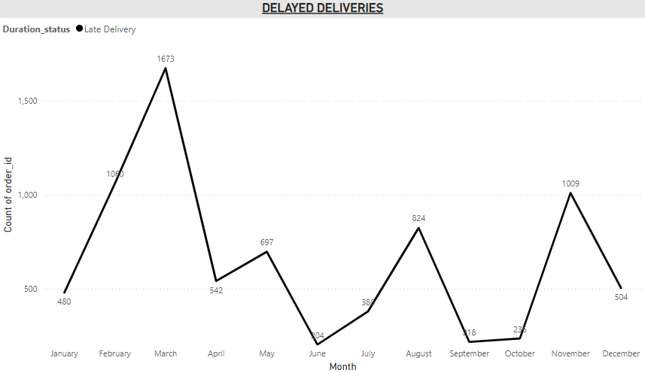
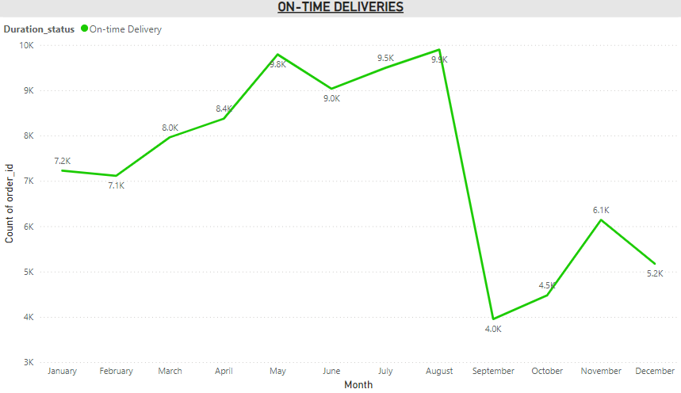
Q8) Create a dynamic visual that compares the number of orders received earlier for each month. Utilize the drill through the cross – report feature to provide a detailed of late and on-time deliveries.
JANUARY
There were a total of 480 orders which were delivered late in January which resulted in high Very bad ratings and sum of payment value was 90.54K
On-time deliveries in January were 7226 with 1022 active sellers and the sum of payment value was 1.1M

Slide 10
FEBRUARY
The total late deliveries in February were 1060. Which is more than half of January. The same way even in February for late deliveries Very bad ratings were higher. And the sum of payment value is 168.05K
On-time deliveries in February were 7115 which is almost equal to January with 1079 active sellers. The sum of payment value is 1.06M

Slide 11
MARCH
Late deliveries in March were 1673. Which is highest among all months Very bad ratings are highest in March and sum of payment value is 278.98K
There were 7964 total on-time deliveries which is more than January and February with 1161 active sellers. The sum of payment value is 1.26M

Slide 12
APRIL
There are 542 orders which were delivered late in April. Which is close to January delayed orders. Here also Very bad ratings are higher. Sum of payment value is 102.15K
On time deliveries in April were 8375 which is highest in first Quarter with 1289 active sellers. The sum of payment value is 1.4M

Slide 13
MAY
Late deliveries in May were 697. Very bad and Excellent rated orders almost equal in May. The sum of payment value is 115.99K
On-time deliveries in May were 9790 with 1393 active sellers and sum of payment value is 1.61M

Slide 14
JUNE
Delayed deliveries is least in June month with 204 orders. With sum of payment value of 52.83K and 92 Very bad rated orders.
On-time deliveries in June are 9033. Which is least in second Quarter with 1428 active sellers. The sum of payment value is 1.46M

Slide 15

JULY
The count of delayed orders in July month is 380. Excellent and Very bad rated orders are slightly close. The sum of payment value is 71.37K
On-time deliveries in July are 9495.Excellent rated order are very high compared to other orders. The sum of payment value is 1.5M and the active sellers are 1509

Slide 16
AUGUST
The late deliveries in August were 824. But the rating for most of these orders are Excellent. Sum of payment value 124.55K
On-time deliveries in August were 9897 which is highest among all months. The active sellers in this month are highest too with 1580 total sellers.

Slide 17
SEPTEMBER
Delayed deliveries in September are second least after June. The sum of payment value is 36.08K
On-time deliveries are least in September among all months with 3953 total deliveries. The active sellers are 695 and sum of total payment value is 655.36K

Slide 18
OCTOBER
Delayed deliveries in October were 236. With 92 Very bad rated orders. The sum of payment value is 39.30K
On-time deliveries in October were 4475. With 803 active sellers and sum of payment value amounts up to 763.32K

Slide 19
NOVEMBER
Total count of delayed orders in November were 1009 Which is highest in last Quarter. Very bad rated orders are highest here. Sum of payment value is 168.84K
On-time deliveries count in November were 6140 which is highest in last Quarter with 868 active sellers. The sum of total payment value is 966.24K

Slide 20
DECEMBER
Total delayed deliveries in December were 504. Very bad orders are highest here and sum of payment value is 103.01K
On-time deliveries in December were 5172. Active sellers are 818 and the sum of total payment value is 765.07K

Slide 21
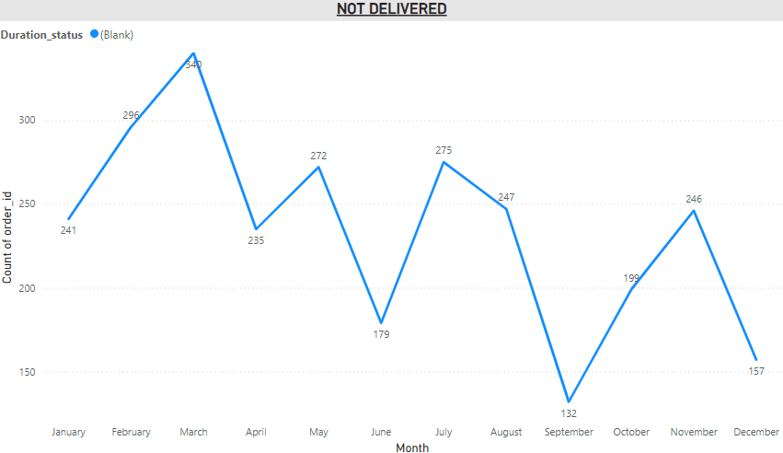
NOT DELIVERED
There are certain orders where the order was placed but the products did not get delivered, the orders either got cancelled or returned back or the products might not be available. The order status might be invoiced, processing, unavailable, shipped but not delivered. The total orders which were placed but did not get delivered are 2965.

